Slide 1
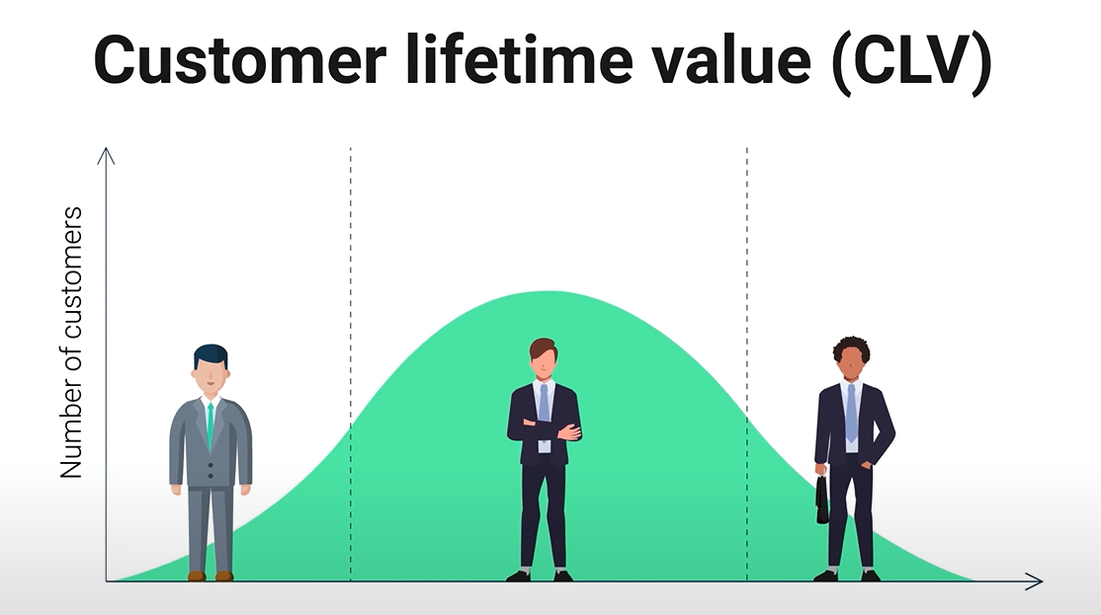
Predicting Customer Lifetime Value (CLV) Using Python
Data-Driven Approach to Estimate Future Customer Spending
Presented By: 2023BCS109 Pruthviraj Jadhav 2023BCS101 Krishna Kalyan
Under the Guidance of: Prof. Amit Nandedkar Sir

Slide 2
Agenda
1
2
3
4
5
Introduction
Primary Goals
Plan
Output
Summary

Slide 3
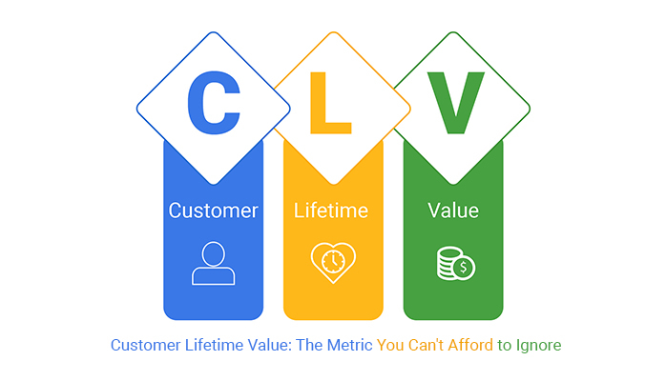
What is CLV
Customer Lifetime Value (CLV) is a metric that estimates the total net profit a company can generate from a customer over their entire relationship.
Understanding CLV allows you to make informed decisions based on how long a customer typically buys from you and what they spend over the lifetime of that relationship. This metric can help inform your strategy on acquisition, customer retention, customer support, and even the quality of your products and services.

Slide 4
Eighty percent of our business comes from 20% of our customers. It costs 10 times less to sell to an existing customer than to find a new customer
“
”

Slide 5
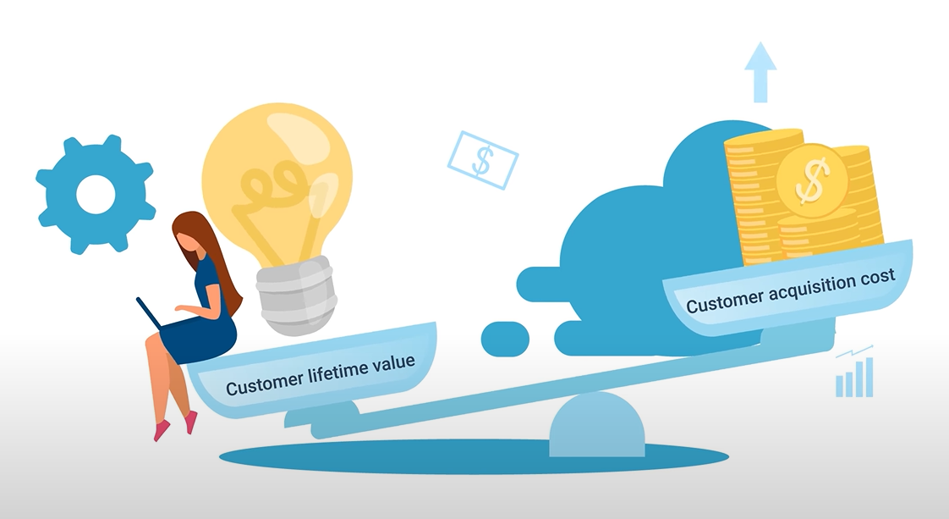
Why CLV_
Eighty percent of our business comes from 20% of our customers.
It costs 10 times less to sell to an existing customer than to find a new customer Businesses prefer retaining customers over acquiring new ones. Businesses are curious to weigh the value of each customer and determine who is truly worth investing in this is exactly when we use customer lifetime value to identify the total worth of a customer based on their relationship.

Slide 6

Primary goal
Predict a customer’s total spending in the next year based on their first few purchases.

Slide 7
Packages Used
Numpy
high-speed mathematical operations
Scikitlearn
Most imp tool for model training
Matplotlib
Turns data into clear visual stories
Pandas
for data cleaning, analysis with DataFrames
Openpyxl
Reads, edits, and creates Excel files programmatically

Slide 8





Plan Connecting Dots
In the search of
Find a most fitting dataset to perform analysis
Taking useful out of it
Data Cleaning & Analysis of cleaned data
Playing with Data
Model Training using Linear Regression & Random Forest Algorithms
Final Output
Output results, visual analysis of predictions.
Future Scope
Customer Segmentation & Power BI Dashboards

Slide 9
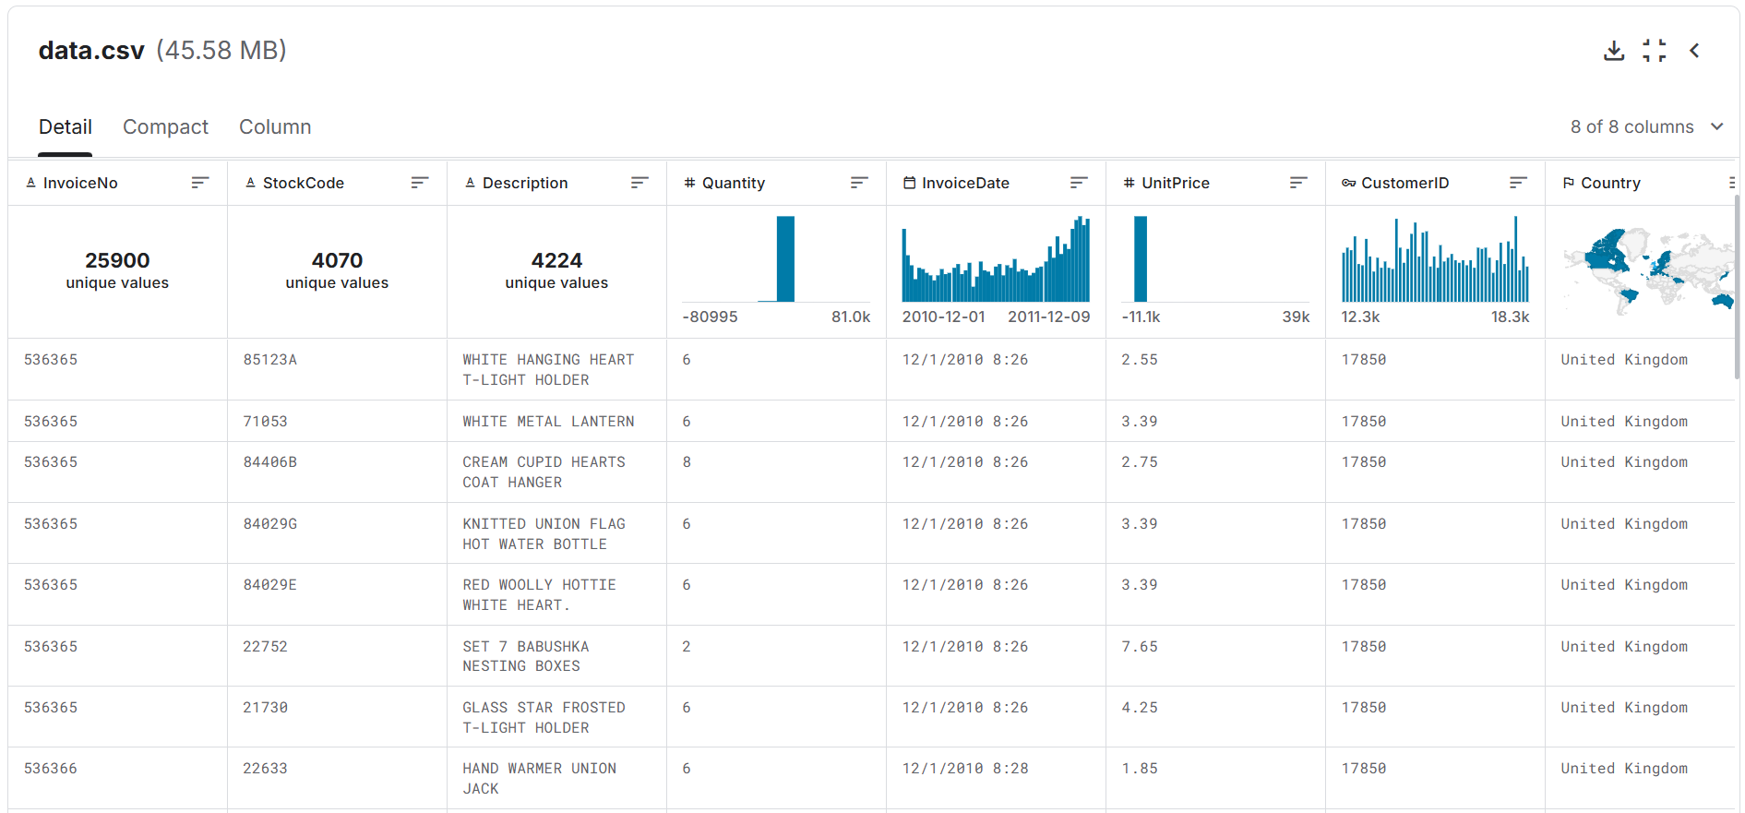
Found a perfect match
In the search of_

Slide 10
Data Set Overview
Sources:
Online Retail Dataset (UCI ML Repository)
E-commerce Transactions Data (Kaggle)
It is a transnational data set which contains all the transactions occurring between 01/12/2010 and 09/12/2011 for a UK-based and registered non-store online retail. The company mainly sells unique all-occasion gifts. Many customers of the company are wholesalers.
It contains 8 columns:
InvoiceNo, StockCode, Description, Quantity, InvoiceDate, UnitPrice, CustomerID, Country

Slide 11
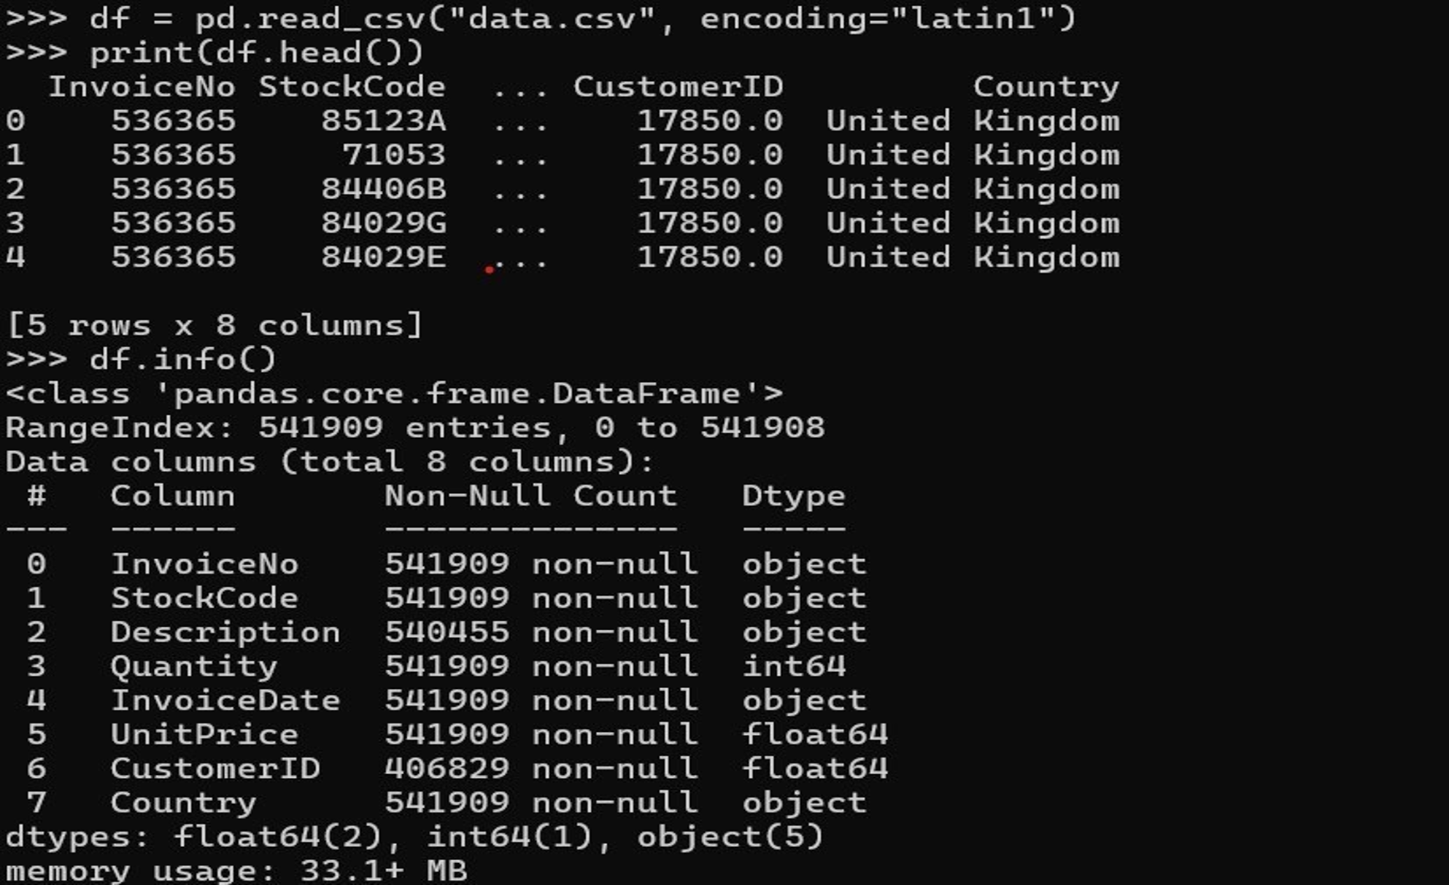
Data Cleaning & Analysis of cleaned data
Taking useful out of it_
Imported raw transactional data (data.csv) with 541,909 records.

Slide 12
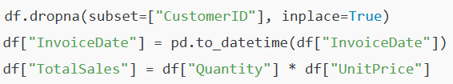
Data Cleaning & Analysis of cleaned data
Taking useful out of it_
Removed missing CustomerID values: removed rows with missing CustomerID Converted timestamps: Converted InvoiceDate into proper datetime format for time-based analysis. Created TotalSales column: Created a new feature TotalSales = Quantity × UnitPrice for revenue per transaction.

Slide 13
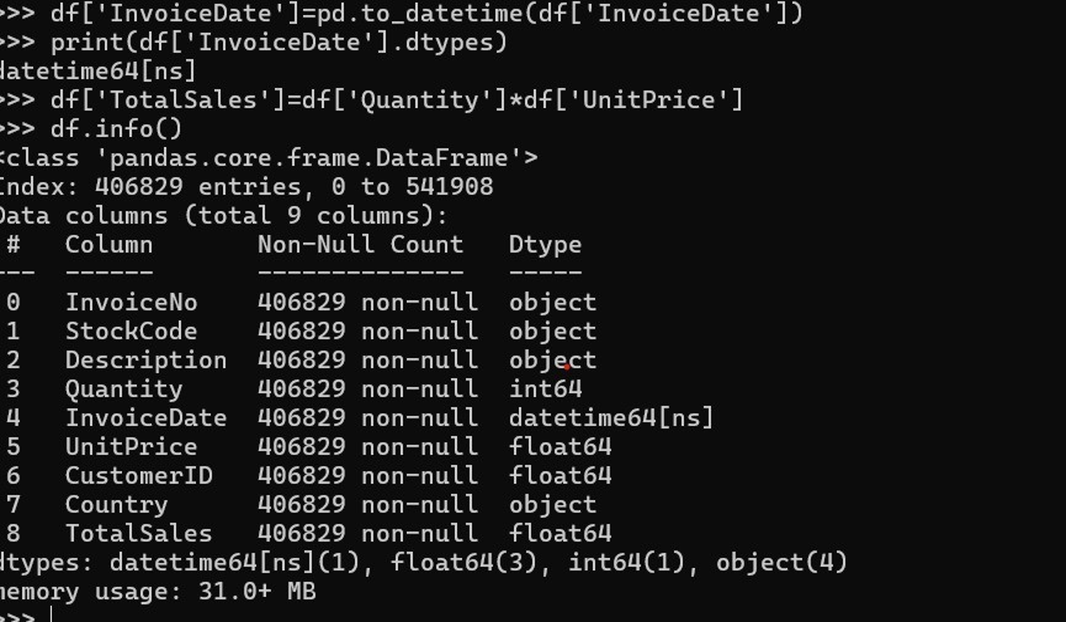
Data Cleaning & Analysis of cleaned data
Taking useful out of it_
Final dataset: 406,829 valid transactions across 8 features + 1 derived feature.

Slide 14
How we get there​
simple and effective methodology used in calculating customer value over a time frame is RFM_
Recency​
Frequency
Monetary
R How recently a customer has made a purchase​ ​
F How often a customer makes a purchase
M Dollar value of the purchases

Slide 15
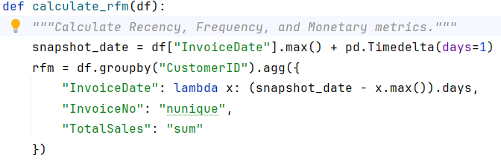
calculating Recency Frequency Monetary​
snapshot date : Sets reference date as day after last transaction in dataset Groups all rows by CustomerID For each customer group, finds their latest purchase date
Calculates days between snapshot and last purchase Counts number of unique invoice numbers per customer Adds up all Total Sales values per customer.

Slide 16
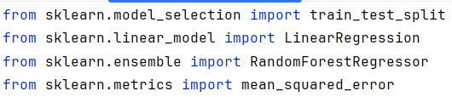
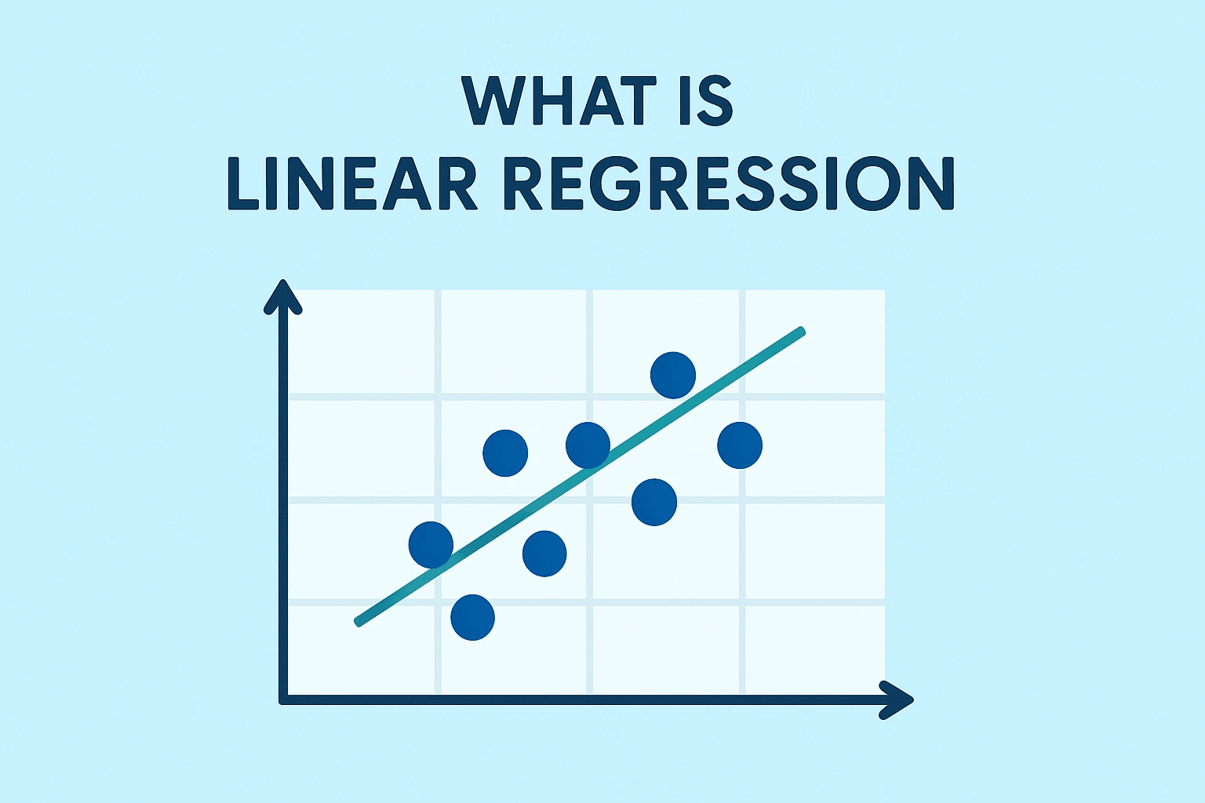
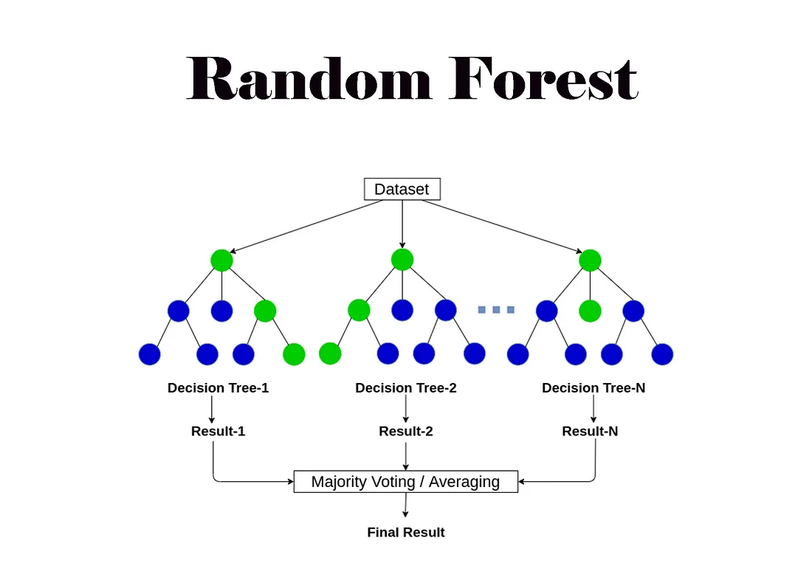
Model Training
Make essential imports Then, we divide data in 2 parts_ 2/3 for training 1/3 for testing
Linear Regression
Random Forest
Model 1
Model 2
Models learns the relationship between features & target from 2/3 rd part and predicts the output which is later compared with actual values from 1/3rd part so as to calculate the accuracy.

Slide 17
Math inside it
The math is mathing_
Takuma Hayashi
FutureMonetary = a×Recency + b×Frequency + c×Monetary + intercept
Graham Barnes
Creates 100 decision trees and combines them

Slide 18

Summary
At Contoso, we believe in giving 110%. By using our next-generation data architecture, we help organizations virtually manage agile workflows. We thrive because of our market knowledge and great team behind our product. As our CEO says, “Efficiencies will come from proactively transforming how we do business.”

Slide 19

Thank you
Mirjam Nilsson
mirjam@contoso.com
www.contoso.com

